Slide 1
React & Redux
Keep your head cool and focused, there’s a tons of stuff to see today
Cedric Hartland

Slide 2
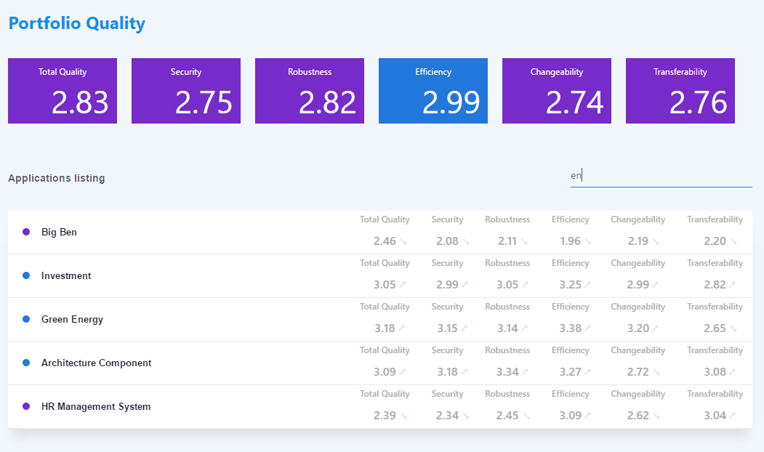
A project we’re targeting

Slide 3
React – a gentle introduction
Javascript library for building user interfaces

Slide 4
React – a library that defines views through components
In a declarative way
Given an application state, renders some shadow DOM such inputs are named properties
Optimized rendering engine inspired from game engines
Little assumption on application structure can “easily” integrate with other technologies
Can render on server side SEO please
What else ? Not so much

Slide 5
React – what’s actually good in it ?
Components
Enhanced reusability well, keep it generic if you plan on reusing…
Rendering lifecycle with optimizations
Basic type checking not so basic with propTypes
Becomes powerful with ES6 and more it’s not react, it’s ES6
Dependency management
Uptaded syntax and language features
Css inclusions
Arguably JSX
As opposed to string based templates

Slide 6
A (not so) simple component
class Tile extends React.Component {
static propTypes = {
value: React.PropTypes.number,
title: React.PropTypes.string
};
render() {
return ( <div className="tile">
<div className="tile-header">{this.props.title}</div>
<div className="tile-value">{numeral(this.props.value).format('0.00')}</div>
</div>
);
}
}
Reusable class or function
Js Expressions in brackets
Properties types
Optional parenthesis wrapping
JSX declarations

Slide 7
Adding user interactions
class Filter extends React.Component {
…
render() {
return (
<div className="filter-input">
<input
type="text"
value={this.props.filterText}
placeholder={this.props.placeholder}
onChange={this.props.handleFilter}
/>
</div>);
}
}
Bind functions to events
Beware, binding to this use ES6 !

Slide 8
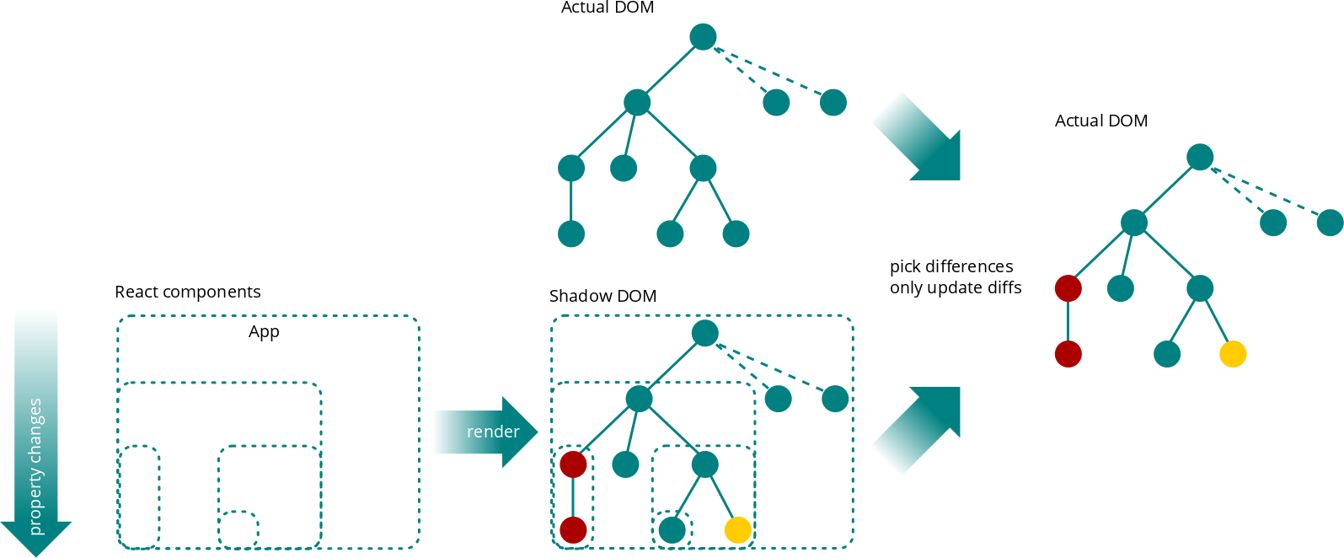
(re-)Rendering workflow

Slide 9
A few words on performance
Mounting (first render) is not cheap estimated x 5 times slower to jquery
Creation of shadow DOM
Rendering of shadow DOM elements to actual DOM
Updating state
Component properties (input) changes trigger re-rendering
Creation of shadow DOM
Rendering of only differences to actual DOM strong impact on performance
Creating and comparing shadow DOMs still not actually cheap
Optimize via shouldComponentUpdate
Bring business logic and guess whether the component should call render at all to reduce impact of creating and comparing shadow DOMs

Slide 10
React
A few words before moving to next topic…
…just in case it was not that clear
React is designed in a declarative way
It can define it’s own internal state, but…
...most components will always return same content for given input and not hold internal state dumb components
No more jquery, backbone or whatever rendering tweaks on user interactions or from other sources
A single DOM source of truth is the output of render function
Application state is not held in component !

Slide 11
React

Slide 12
Redux, a sweet introduction
Single source of truth, read-only state, pure functions

Slide 14
React & Redux
Rock & Roll

Slide 15
Wait, there’s more
Build, enhanced development process and how to test

